Slide 1
Website- https://www.rakuten.co.jp

Slide 2
User Interface Design
Findings and Observations

Slide 3
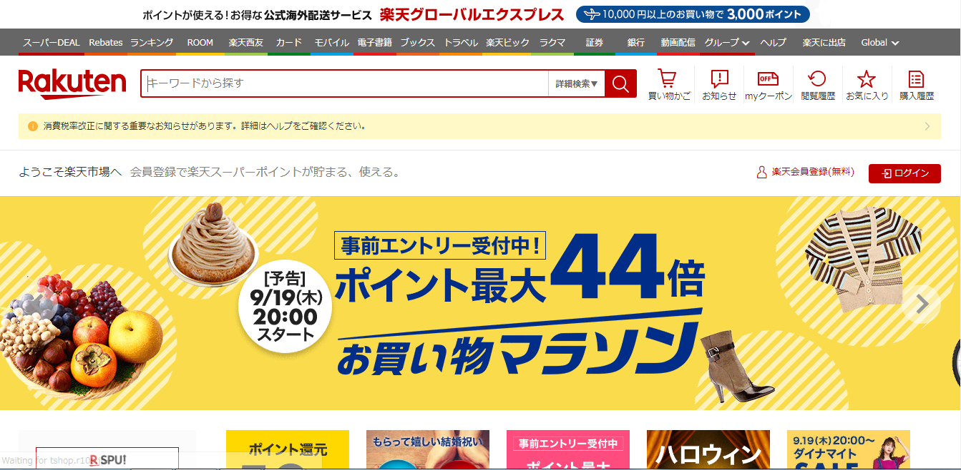
Home Page
1
3
2
4
5
6
7

Slide 4
What Looks Good In Home Page
At top of the home page Link is given to go to rakuten global express.
Option to use different services offered by Rakuten are displayed for eg:Banking,Media,etc.
Global option is given to access website in different languages such as English,French,etc.
Contains search tab to search different products.
Register button after the services section link in red color with symbol of person.
Login button in red color after the services section and besides register link with right arrow symbol.
Image Slider giving information about different events and the offers offered by rakuten.

Slide 5
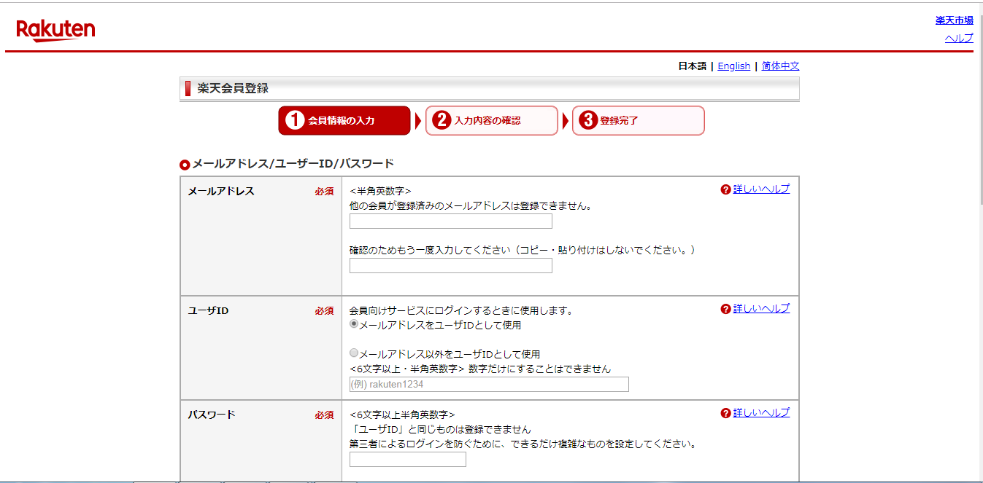
Registration Page
7
1
2
3
4
5
6

Slide 6
What Looks Good in Registration page
Language change options to change the language of registration page to English or again to Japanese.
Current phase is indicated in red color whereas other two phases are in white color.
Registration details labels font is Times New Roman and font Size is 10 with black color text and bold.
Radio option is given to select whether person wants to keep his email id as username or he want different username with validation condition.
Detailed help link is given in blue color for every field.
For every field required is mentioned after headers in red color
When clicked on this link redirected to home page

Slide 7
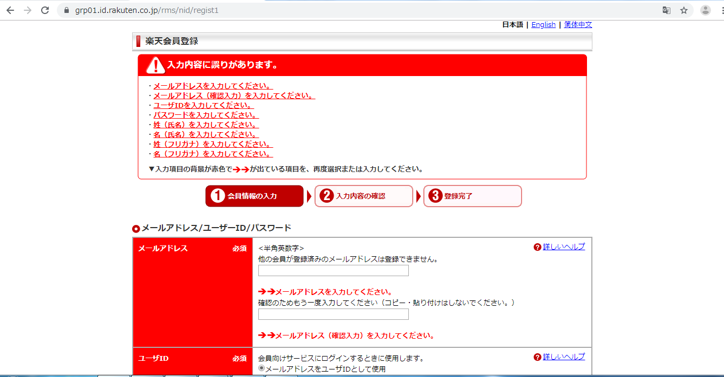
Registration Page
1
2
3
4

Slide 8
What looks good Registration error page
Error messages are displayed in rectangular box which contains warning symbol and something wrong text.
Error message link are displayed. When clicked on link then focus is redirected to particular error.
Header section of every field gets red in color as error as occurred.
Under each and every field wherever error has occurred error is shown.

Slide 9
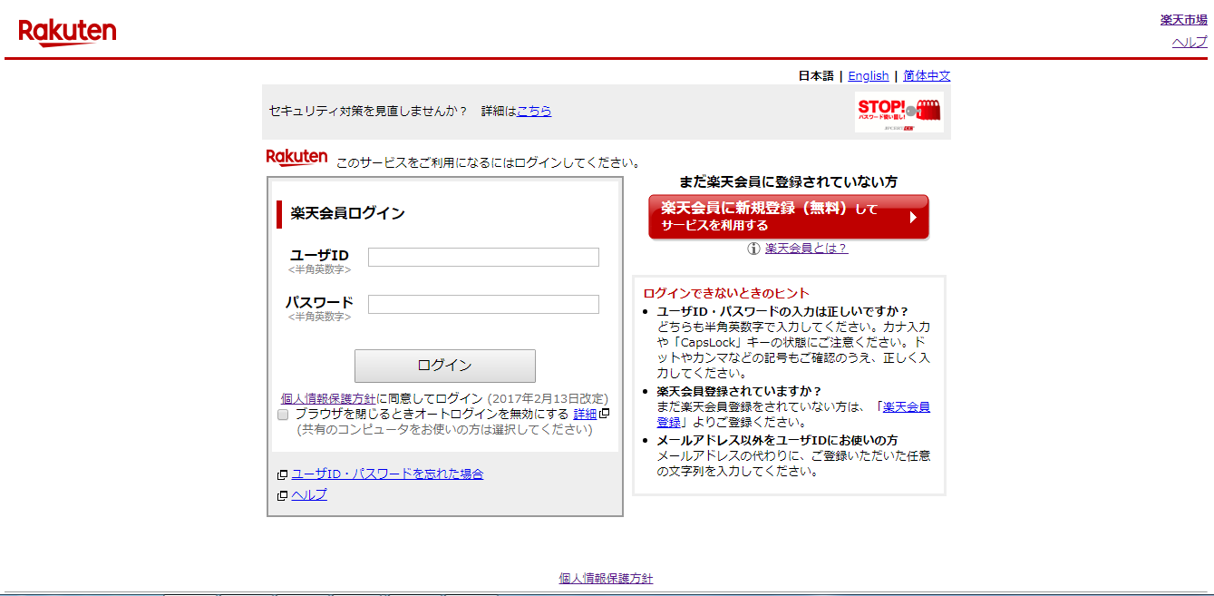
Login Page
1
5
2
4
9
3
6
7
8

Slide 10
What looks good in Login page
Member login title is left aligned inside rectangular box in black color
After clicking on textbox border color turns blue and background color of textbox turns light red in color.
On mouse hover link color changes blue to purple.
Conditions are displayed in rectangular box to be checked before attempt to login.
Registration Tab is given when clicked on page is redirected to registration page.
Check box is given to disable auto login if the login is not done from private device.

Slide 11
Link is given to check details about privacy policies of the organization.
Forgot user Id/password link is given so that it can be changed is easily.
Login button color is grey in color with black color text before the checkbox.

Slide 12
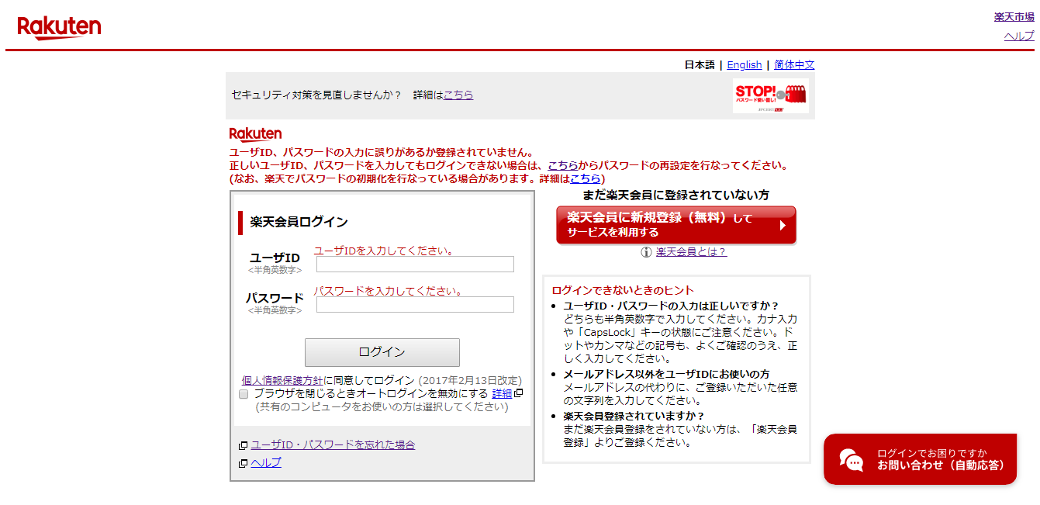
Login Page
4
1
2
3
5

Slide 13
What looks good in Login Error Page
Error message is displayed in red color either user not registered or something went wrong.
Forgot user id/password link is given with error message.
For every text box specific required error is displayed.
Link is given which helps to secure login with strong user id and password.
Chatbot is popped to chat with organizations help section and get help.

Slide 14
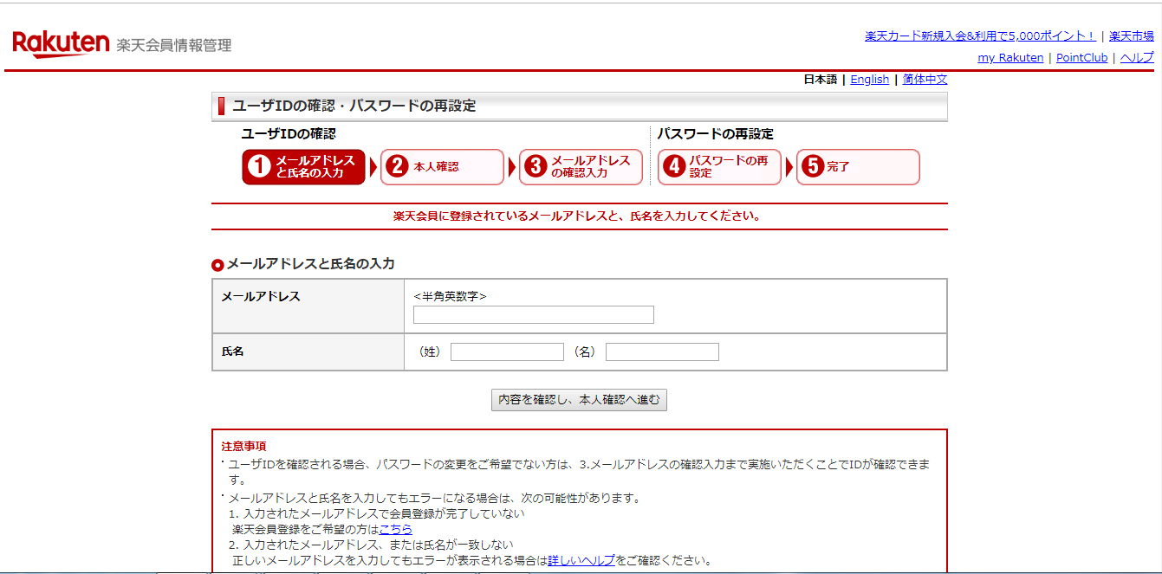
Forgot Password Page
3
1
2
4

Slide 15
What looks good in Forgot password page
Header is given in rectangular tab with grey background which has times new roman font and font size is 12.
Forgot password works in 5 phases in first three phases email id confirmation is done and if we don’t want to reset password we can stop after three phases.
Language change links are given so we can change language of the forgot password to English or again we can change to Japanese.
Registration link is given because if user has not registered he /she can register

Slide 16
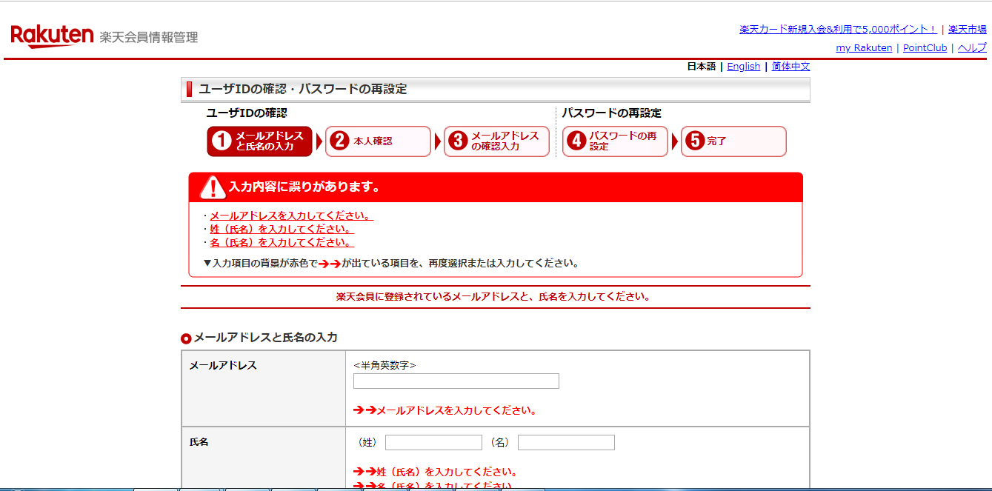
Forgot Password Page
1
2
3

Slide 17
What looks good in Forgot password error page
Show error messages in rectangular box with warning symbol in header.
The error messages which are in rectangular box work as a link which directly points to the particular error.
Particular error is displayed in the section where the error has occurred in red color.

Slide 18
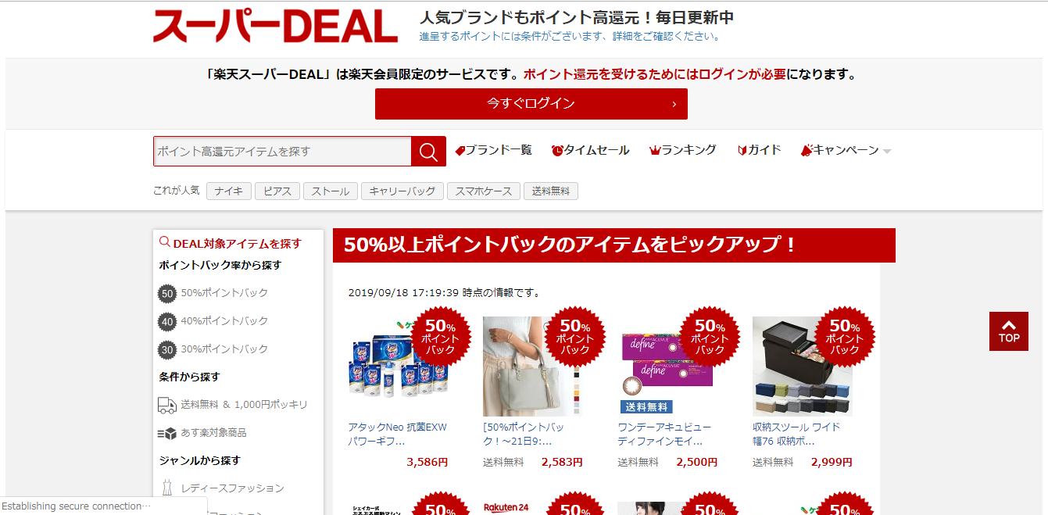
Super Deal Page
5
6
1
8
7
4
3
2

Slide 19
What looks good in Super deal page
Search tab is provided to search specific product
In this section deals links is provided so that available deals can be directly checked.
The time and date is displayed when deal will end.
Top button is provided which is on right side of the page.
Log in button is provided .

Slide 20
When clicked on button popup is displayed with what are the current deals or shout out deals.
Filter tabs are given of different popular brands such as Nike,etc.
When clicked on this button it takes to the particular deal page.

Slide 21
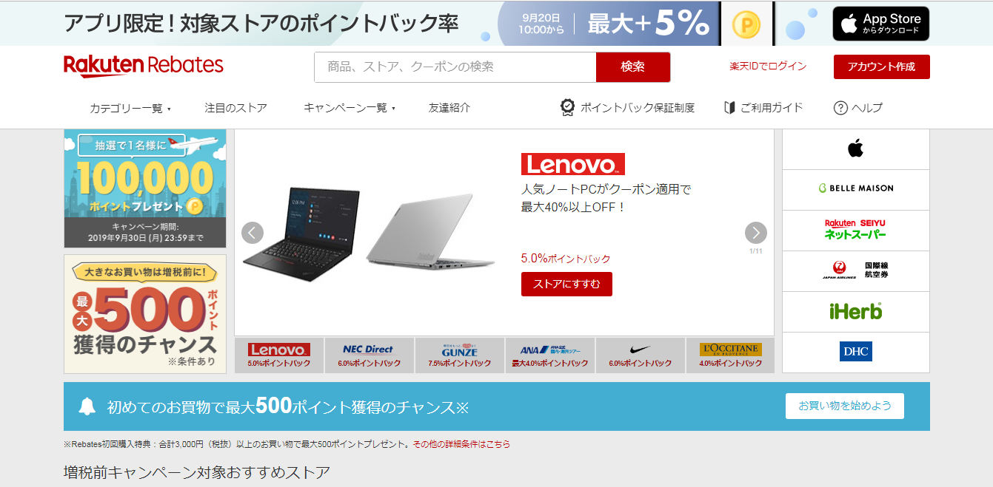
Rakuten Rebate Page
4
1
2
3
5
6

Slide 22
What looks good in Rakuten Rebate Page
Clicked on this tab page is redirected to the products organization page.
This section contains tabs with name of organization as rebate page campaigns for different organizations and its products.
Image is clickable .When image is clicked page is redirected to products page.
When clicked on tab drop down is displayed for the different products available under rakuten rebate.
When clicked on button page is redirected to login page directly.
When clicked on link page goes down to guide or information section.

Slide 23
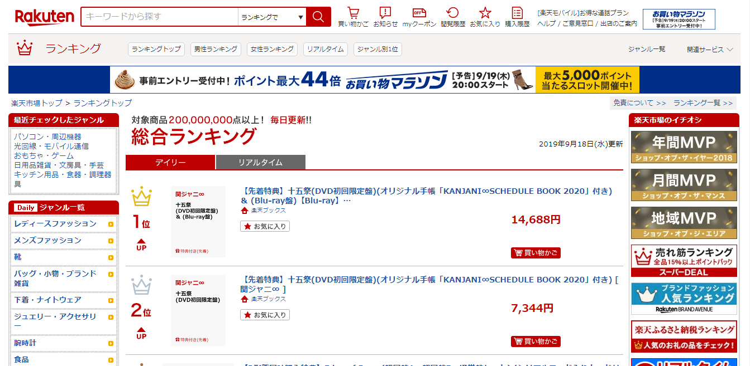
Rakuten Ranking Page
5
1
3
2
4

Slide 24
What is good in Rakuten ranking page
Separate section is displayed for electronic devices when clicked on it page is redirected to products page.
Products are ranked as per the conditions and if product is bought more than “UP” is denoted or else “DOWN” is denoted.
If product is highest ranked than it is denoted with golden crown.
This section contains different categories of products where products are ranked on daily basis.
When clicked on tab page is redirected to directory page all the products available under Rakuten are listed out as per category.

Slide 25
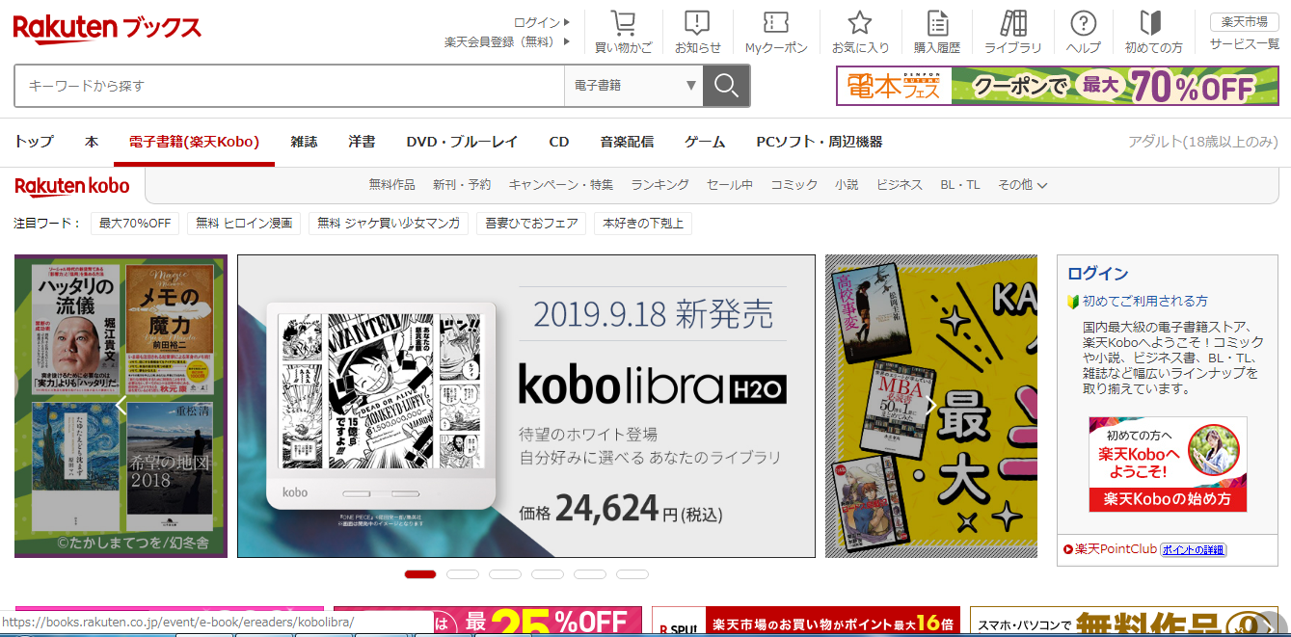
Rakuten Books Page
3
2
1

Slide 26
What looks good in Rakuten Books Page
The image slider is clickable . When image is clicked page is redirected to particular book page
Tabs of different book publishing companies are displayed so when clicked on that books of particular publication are available.
The different formats of books such as DVD,E-BOOK, CD,etc are mentioned so that books can be filtered as per format.

Slide 27
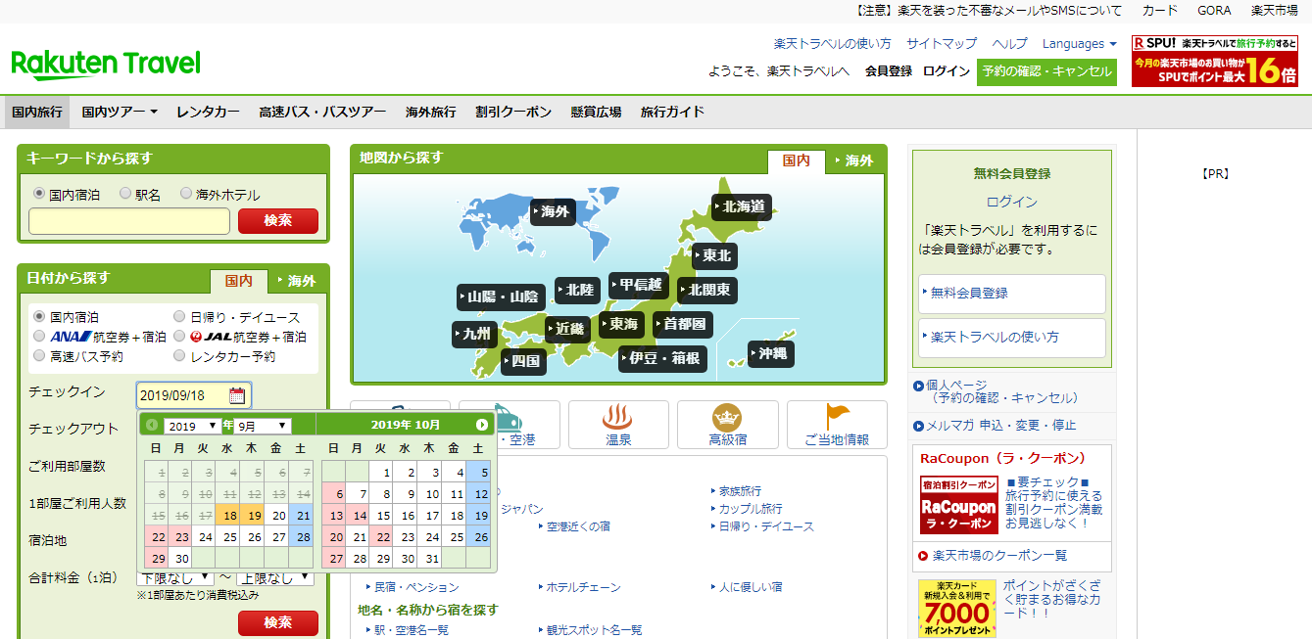
Rakuten Travel Page
5
7
1
8
3
4
6
2

Slide 28
What looks good in Rakuten Travel Page
The map is given with different places in Japan that can by travelled using different means of transport like Train,Flight,etc.
In Calendar section we can see that two months calendar is displayed and the dates before the current date are disabled.
Different Flight Companies name are displayed from which we can select through which flight we want to travel.
Different stay option are displayed in image tab format.
Search option is given to search information about different places in Japan .
In calendar section dates on which weekly off is there are mentioned in blue color.
The Date selected To-From are in light brown color. When we go to particular date background color changes to light yellow.
Off Days are mentioned in light red color in background.

Slide 29
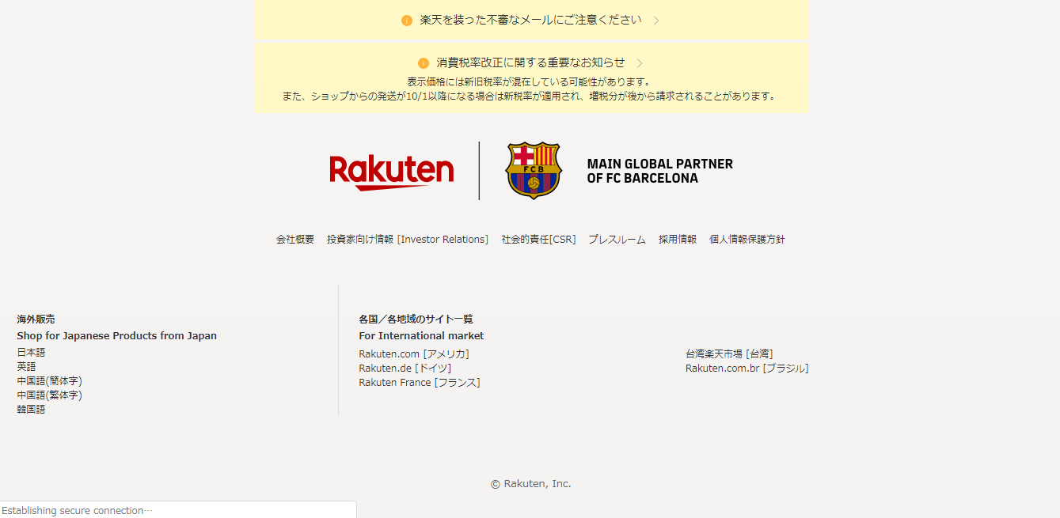
Footer Page
1
3
2

Slide 30
What looks good in Footer Page
Logo is clickable. After clicking on logo page is redirected to collaboration page.
Links of different rakuten markets are given when clicked on it page is redirected to particular site.
Footer color is grey and text color is black

